Slide 1
Dr. Maher jabbar salih
Medical oncologist
Leturer at al-basrah medicine college
November – 2022-2023

Slide 2
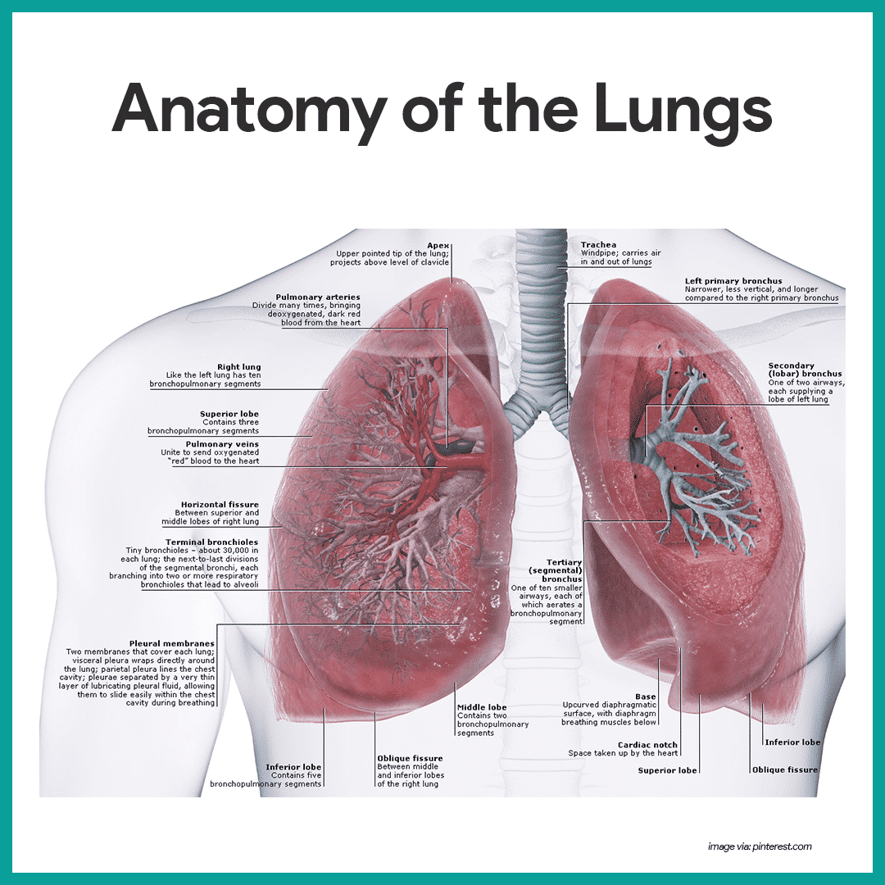

Slide 3
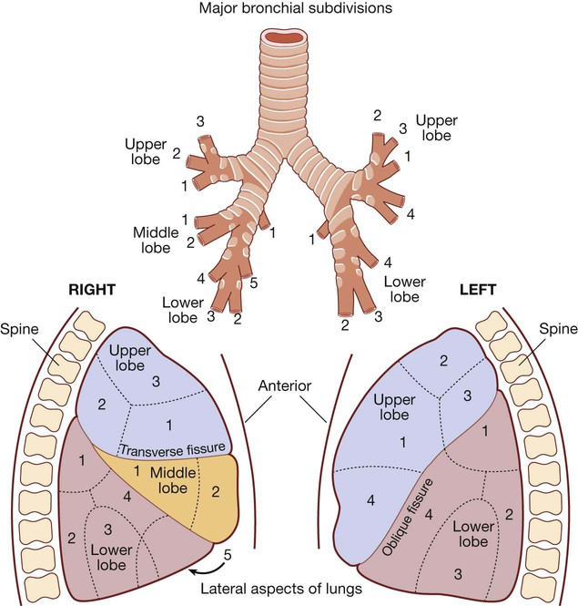
Respiratory system :

Slide 5
Presenting problems in respiratory disease
Cough :
Cough is the most frequent symptom of respiratory disease and
is caused by stimulation of sensory nerves in the mucosa of the
pharynx, larynx, trachea and bronchi

Slide 6
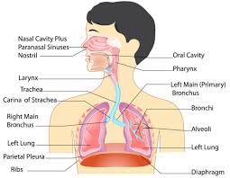
Causes of cough

Slide 7
Breathlessness
Breathlessness or dyspnoea can be defined as the feeling of an uncomfortable need to breathe.

Slide 8
Causes of breathlessness
Cardiovascular *Acute pulmonary oedema
Respiratory *Acute severe asthma
*Acute exacerbation of COPD
*Pneumothorax
*Pneumonia
*Pulmonary embolus
ARDS
Others : Severe anaemia , Obesity,acidosis….

Slide 9
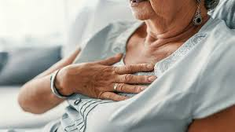
Chest pain
Chest pain can result from cardiac, respiratory, oesophageal or musculoskeletal disorders.
ECG….

Slide 10
Haemoptysis
Coughing up blood, irrespective of the amount, is an alarming symptom and patients nearly always seek medical advice.
Care should be taken to establish that it is true haemoptysis and not haematemesis, or gum or nose bleeding.

Slide 12
CauseCauses of haemoptysiss of haemoptysis
Bronchial disease
• Cancer*
• Bronchiectasis*
• Acute bronchitis*
• Bronchial adenoma
• Foreign body
Parenchymal disease
• Tuberculosis*
• Suppurative pneumonia
• Parasites (e.g. hydatid
disease, flukes)
• Lung abscess
• Trauma
• Actinomycosis
• Mycetoma
Lung vascular disease
• Pulmonary infarction*
• Goodpasture’s syndrome
(p. 612)
• Polyarteritis nodosa
• Idiopathic pulmonary
haemosiderosis
Cardiovascular disease
• Acute left ventricular failure*
• Mitral stenosis

Slide 13
Obstructive lung diseases:
1- asthma
2-COPD
3-bronchectasis
Restrictive lung disease :
Lung fibrosis

Slide 14
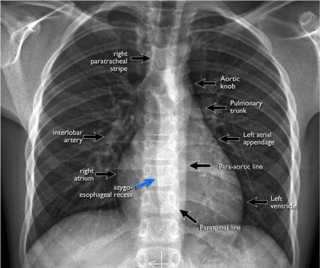
Important investigations
CXR

Slide 16
Thanks

Slide 18
العملي

Slide 19
SEQUELE :

Slide 21
Possibly related to xerostomia and reduced buffering capacity of saliva secondary to medication
Gastro‐oesophageal reflux symptoms 3 times more prevalent in asthma (bidirectional relationship – acid in the distal oesophagus increases airway reactivity and inhaled asthma medication may be swallowed, causing irritation)
Beta‐2‐agonists and drugs such as theophylline may also cause relaxation of other smooth muscles such as the lower oesophageal sphincter, leading to reflux .

Slide 23
WEGNER GRANULOMATOSIS – VASCULITIS

